Slide 1

CUSTOMER CARE REGISTRY
CUSTOMER JOURNEY MAP

Slide 2

TEAM DETAILS:
Team No College Name
Department
: IBM-Project-11360-1659321307
: St.Jospeh’s college of engineering
: Information Technology
PROBLEM MEMBERS :
Lakshman S
Nandha Kumar BK
Karthik Raja R
Mugesh G

Slide 3
PROJECT DESIGN PHASE –II
CUSTOMER JOURNEY MAP
DATE | 08 October 2022
TEAM ID | IBM-Project-11360-1659321307
PROJECT NAME | CUSTOMER CARE REGISTRY
MAXIMUM MARKS | 2 Marks
Customer Journey Map
3

Slide 4
STAGE | AWARENESS | CONSIDERATION | DECISION | SERVICE | LOYALTY
CUSTOMER ACTIVITIES | see social media campaign Hear about from friends | Conduct reach, compare features and pricing | Make a purchase | Contact customer service, Documentation,r ead product and service | Share the experience
TOUCHPOINTS | Social media, Traditional media , word of mouth | Social media, Websites | Website, Mobile app | Chatbot, Email notification | Social media,word of mouth Review sites
CUSTOMER EXPERIENCE | Interested, Hesitant | Curious, Excited | Excited | Frustrated | Satisfied, Excited
KPIS | customer feedback | New website visitors | Conversional rate | Waiting time, customer service score | Customer satisfaction score
RESPONSIBLE | Communications | Communications | Customer service | Customer service | Customer service, Customer success
Customer Journey Map
4

Slide 5





USER ICON
User can tack the
issue to open
User first login
issue in the
Web Portal
L
o
g
o u t

Slide 6
0
1
2
4
3
5
5
Customer Journey Map

Slide 7


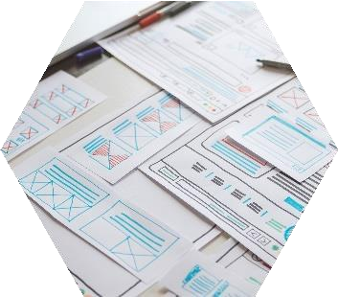

Thank you

